Slide 1
Disparities in Access to Water and Sewer Services in North Carolina
Background and Preliminary Results
Jacqueline MacDonald Gibson, Associate Professor
Gillings School of Global Public Health
University of North Carolina at Chapel Hill
September 18, 2014

Slide 2
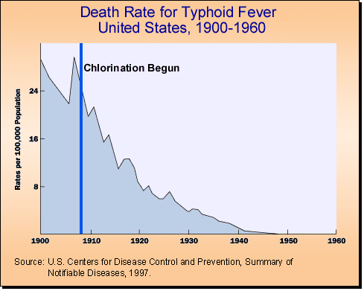
Water and Sanitation Service Led to 20th Century Public Health Gains

Slide 3
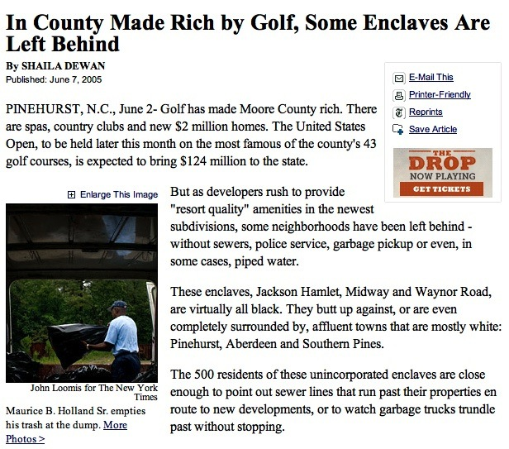
Some Communities Were Left Behind
New York Times, 2005:
“Golf has made Moore County rich. . . .
But as developers rush to provide ‘resort quality’ amenities in the newest subdivisions, some neighborhoods have been left behind—without sewers, police service, garbage pickup, or . . . piped water.”
Notes:
22% of North Carolinians lack community water service.
High relative to other states.
Nationwide, 8% of population lacks water access.
49% lack sewer service in NC, compared to 24% nationally.

Slide 4
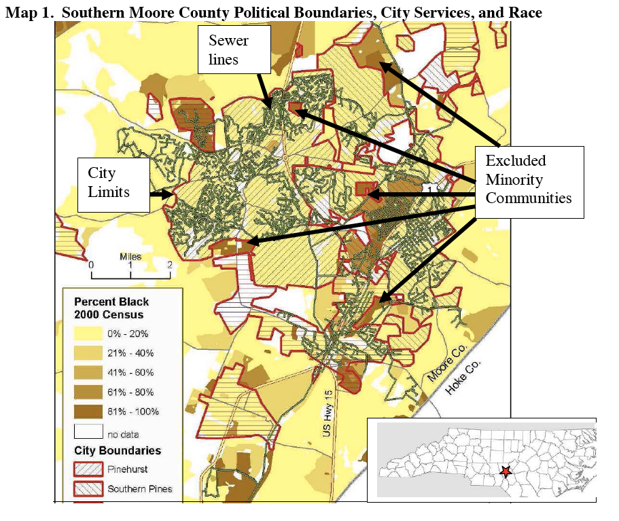
Some Unserved Communities Border Municipal Utility Pipes
Moore County (Pinehurst) example:
Irregular city boundaries exclude minority communities
Source: Cedar Grove Institute for Sustainable Communities

Slide 5
Research Objective
  Characterize health benefits of extending water and sewer services and factors influencing decisions to extend services.
    Focus on “extraterritorial jurisdictions”

Slide 6
Three Specific Aims
  Map affected communities.
  Characterize well water quality and health risks.
  Identify barriers and solutions to service extensions.

Slide 7
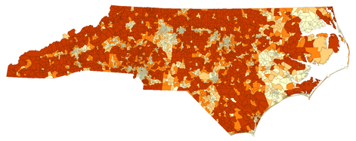
Three Specific Aims
  Map affected communities.
    Mine publicly available data (U.S. Census, county tax records)
  Characterize well water quality and health risks.
  Identify barriers and solutions to service extensions.

Slide 8
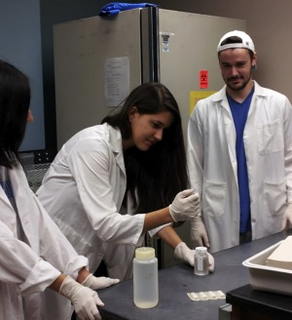
Three Specific Aims
  Map affected communities.
    Mine publicly available data (U.S. Census, county tax records)
  Characterize well water quality and health risks.
    Well water sampling (Wake County)
    NC Division of Public Health private well data (other counties)
  Identify barriers and solutions to service extensions.

Slide 9
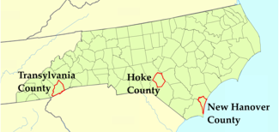
Three Specific Aims
  Map affected communities.
    Mine publicly available data (U.S. Census, county tax records)
  Characterize well water quality and health risks.
    Well water sampling (Wake County)
    NC Division of Public Health private well data (other counties)
  Identifies barriers and solutions to service extensions.
    Key informant interviews (n=23)

Slide 10
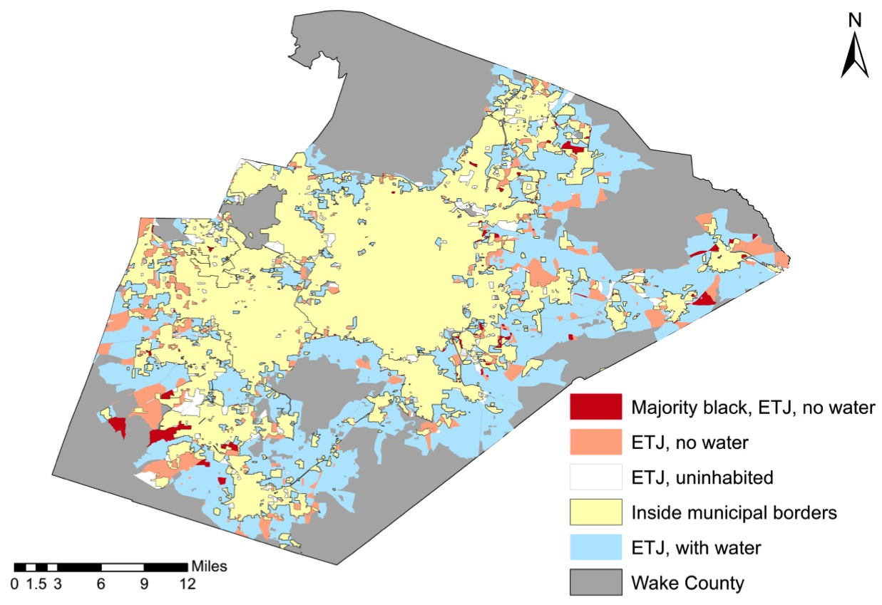
Results, Objective 1: Tax Data Reveal Unserved Wake County Areas
Data sources:
  Demographics: U.S. Census (2010)-block level
  Water service: Wake County tax records (parcel-by-parcel analysis)

Slide 11
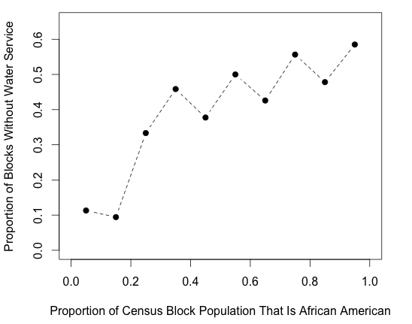
Race Is Significantly Associated with Water Access in Extraterritorial Jurisdictions

Slide 12

Poor Well Water Quality Is Associated with Excess Emergency Department Visits
53 emergency department visits for acute gastrointestinal illness (AGI) for every 1,000 people drinking from wells positive for coliform bacteria

Slide 13
Cancer Risks Are Higher for Well Users
Notes:
Point out cancer risks still low, 3.5 cases per 10,000 well users per year on average.

Slide 14
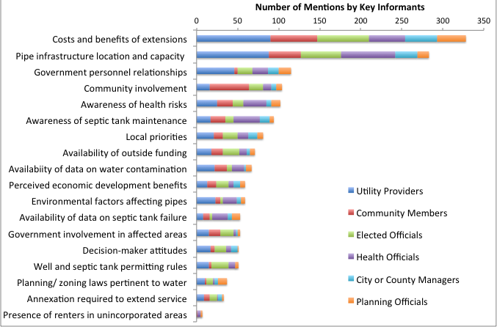
Key Informants Suggest Cost Is the Major Barrier to Extending Service

Slide 15
Interviews Also Suggest Opportunities for Health Departments to Help
Broker intergovernmental relationships

Slide 16
Interviews Also Suggest Opportunities for Health Departments to Help
Educate decision-makers about health risks

Slide 17
Interviews Also Suggest Opportunities for Health Departments to Help
Educate community about septic system maintenance

Slide 18
Interviews Also Suggest Opportunities for Health Departments to Help
Gather data on well water quality and septic system failure rates

Slide 19
Summary
  Mapping reveals that racial disparities in water service may persist in extraterritorial jurisdictions in Wake County.
  Water sampling suggests water quality in some domestic wells is poor and is associated with increased health risks.
    Increased risks of emergency department visits for acute gastrointestinal illness.
    Increased cancer risks (though risks are very low).

Slide 20
Roles for Public Health Practitioners
  Broker intergovernmental relationships.
  Educate key decision-makers about public health risks :
    Gather data on septic system failure rates and well water quality.
    Present to key decision-makers.
  Continue to educate affected communities about maintenance and testing of septic systems and wells.

Slide 21
Acknowledgements
  This research was supported by a grant from the Robert Wood Johnson Foundation under the Mentored Research Scientist Development Program in Public Health Systems and Services Research

Slide 22
Questions?

